Slide 1
Advanced big Data Analytics Project
Manikandan Lalitprasad

Slide 2
Churn Analysis
OBJECTIVE
To build an end-to-end Spark Machine Learning Application using Spark, SQL and Python in Databricks environment
INITIAL STEPS
Setting up a cluster to run Spark jobs
Import the data in the Workspace

Slide 3


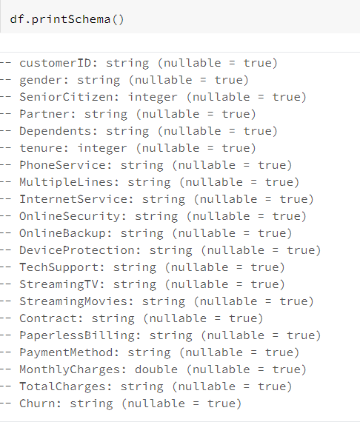
Dataset – Telecom Churn data
Dataset has many categorical variables and the services which the users subscribed to, monthly charges and total charges paid by the customer and target variable is whether the customer has churned or not.

Slide 4
Preprocessing
Check for null values
Convert to Pandas Data frame

Slide 5
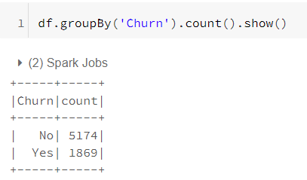
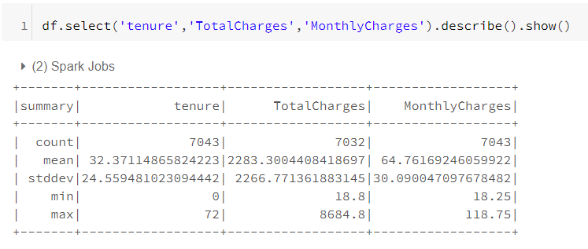
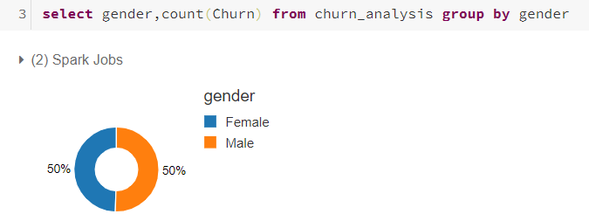
Data analysis

Slide 6
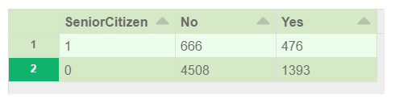
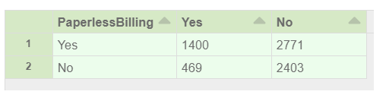
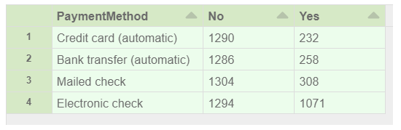
Initial insights
Senior Citizens are more likely to churn
People with Paperless billing are more likely to churn
People with Electronic check have higher proportion of Churn rate

Slide 7
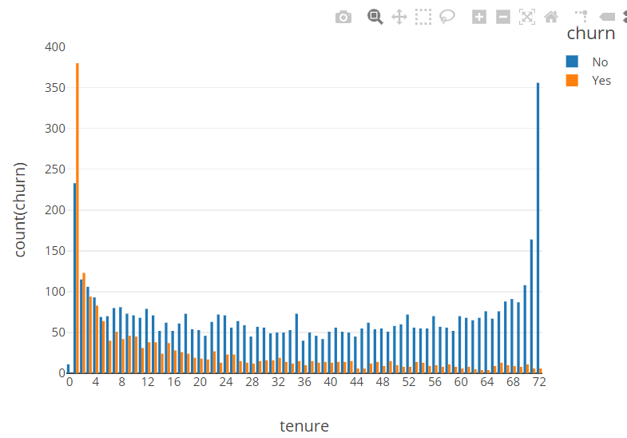
Customers tend to churn in the initial tenure. As the tenure increases, there is less churn

Slide 8
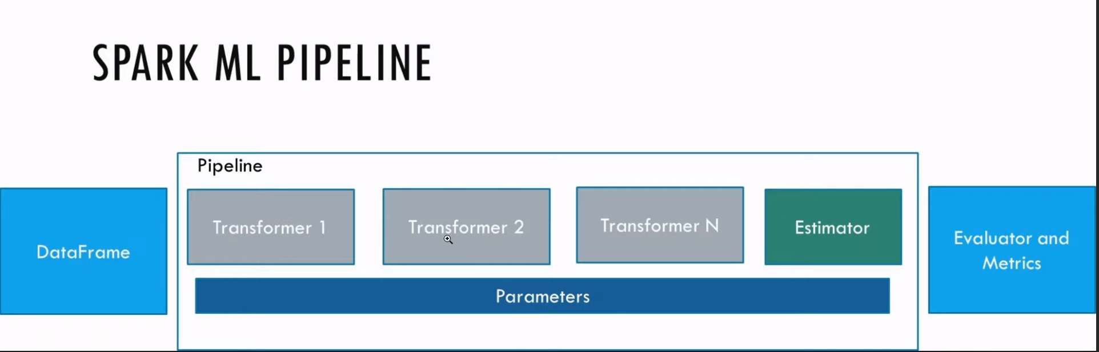
Transformers – contains feature engineering components Estimators – for machine learning modeling Parameters – number of bins

Slide 9
Transformer 1 – Defining all my categorical columns and convert to numerical
Transformer 2 – Handling numeric values
Transformer 3 – Assign Churn to stages
Example: Churn – Yes converted to 1.0
The String Indexer is used to convert categorical to numerical. It assigns based on the maximum count of values. Since No is more it gives 0 index to No and 1 to yes

Slide 10
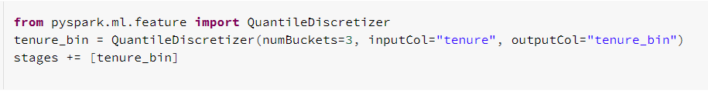
Create 3 buckets and output to tenure bin. Split tenure into 3 bins
Vector Assembler –Assemble the features into vectors for the model. It take all values and create an array, that is going to be the input to the model
Pipeline – Does all the stages one after the other
Fit the train data to pipeline
Transform the data

Slide 11
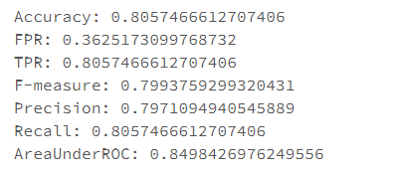
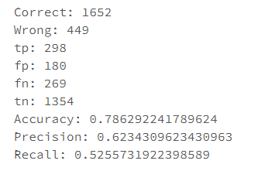
Logistic Regression
Run a logistic regression with label and features
Coefficients and Intercept
Train data Test Data

Slide 12
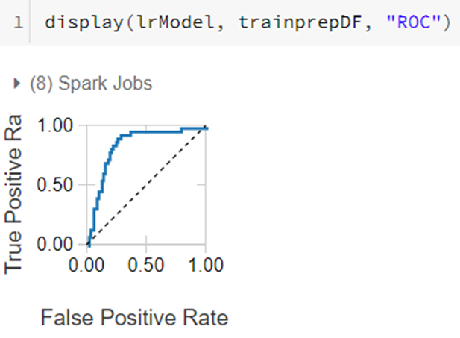
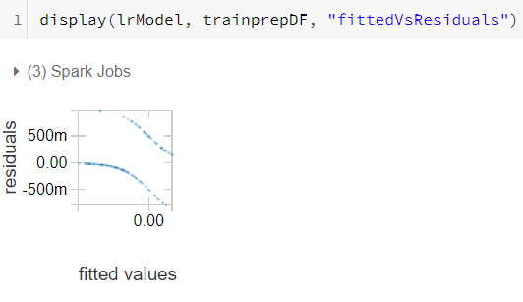

Slide 13
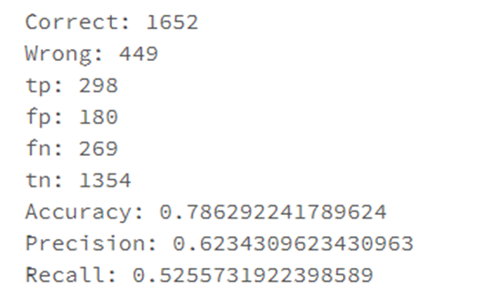
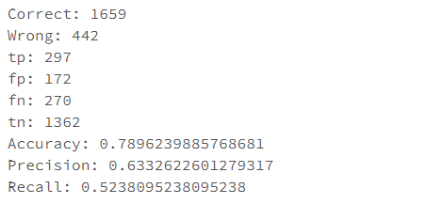

Test Data After Cross Validation
Precision and Recall almost remains the same, no improvement with Cross-Validation.
Training data has caused overfitting

Slide 14
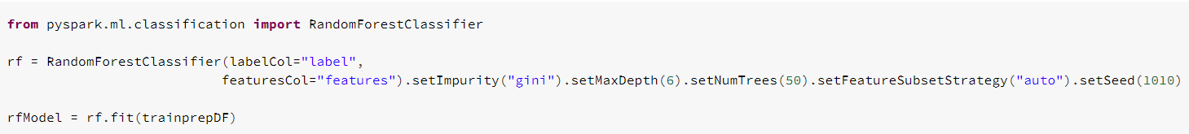
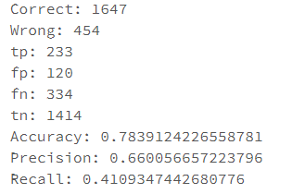
Random forest classifier
Precision has increased, Recall has decreased
Precision is basically what % of churn user did our model identify out of total user which we predicted as churn
Recall – Out of number of users really churned, how much users did we identify correctly.
Depends on our business objective whether we want to focus on Precision or recall or any other factor.

Slide 15
REFERENCES
Dataset taken from Kaggle - https://www.kaggle.com/mnassrib/telecom-churn-datasets
AI Engineering YouTube https://www.youtube.com/channel/UCwBs8TLOogwyGd0GxHCp-Dw
https://academy.databricks.com/catalog

